Slide 1
International Conference on Contemporary Management - 2024
Social as Epiphenomenon of Economics!
Experimenting the Social Enterprise Intention of Non-STEM University Students
^{*1}DIJ Samaranayake
²S Maheswaran
³A.Mithursan
*Department of Management Studies, Faculty of Management, University of Peradeniya
*Department of Operations Management, Faculty of Management, University of Peradeniya
*Department of Management Studies, Faculty of Management, University of Peradeniya

Slide 2
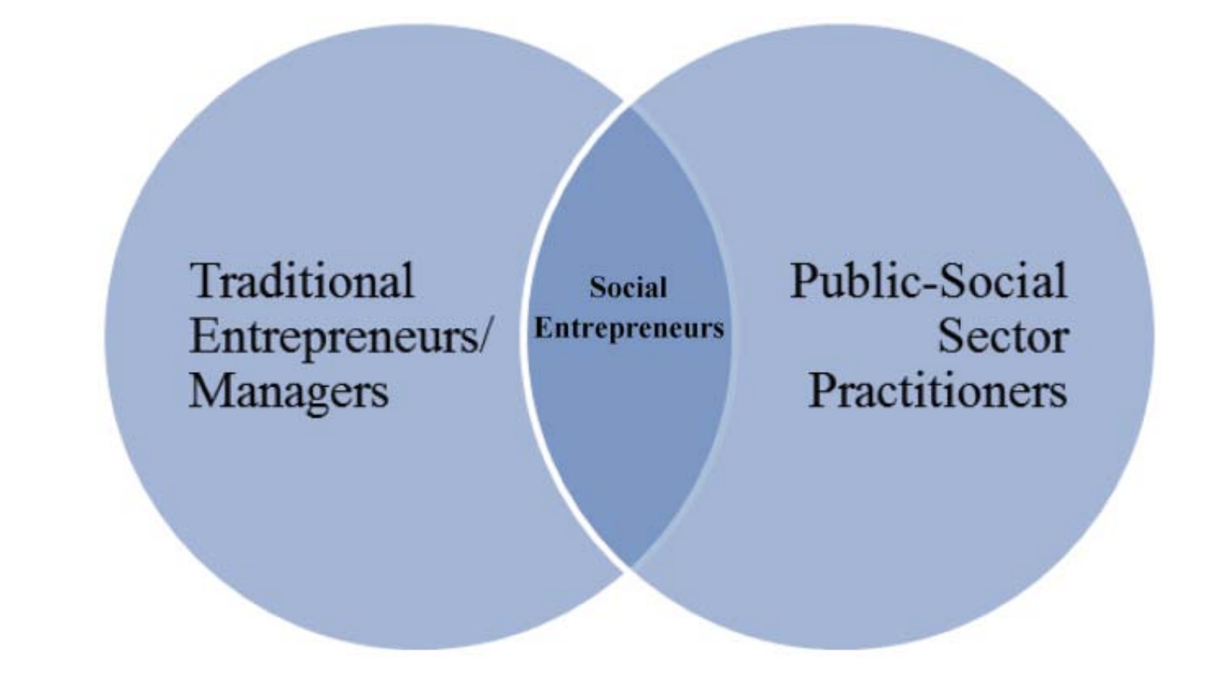
Theory [cont.]
Pathways to social entrepreneurship: Germak & Robinson (2014)
Worshipping two gods at the Same time

Slide 3
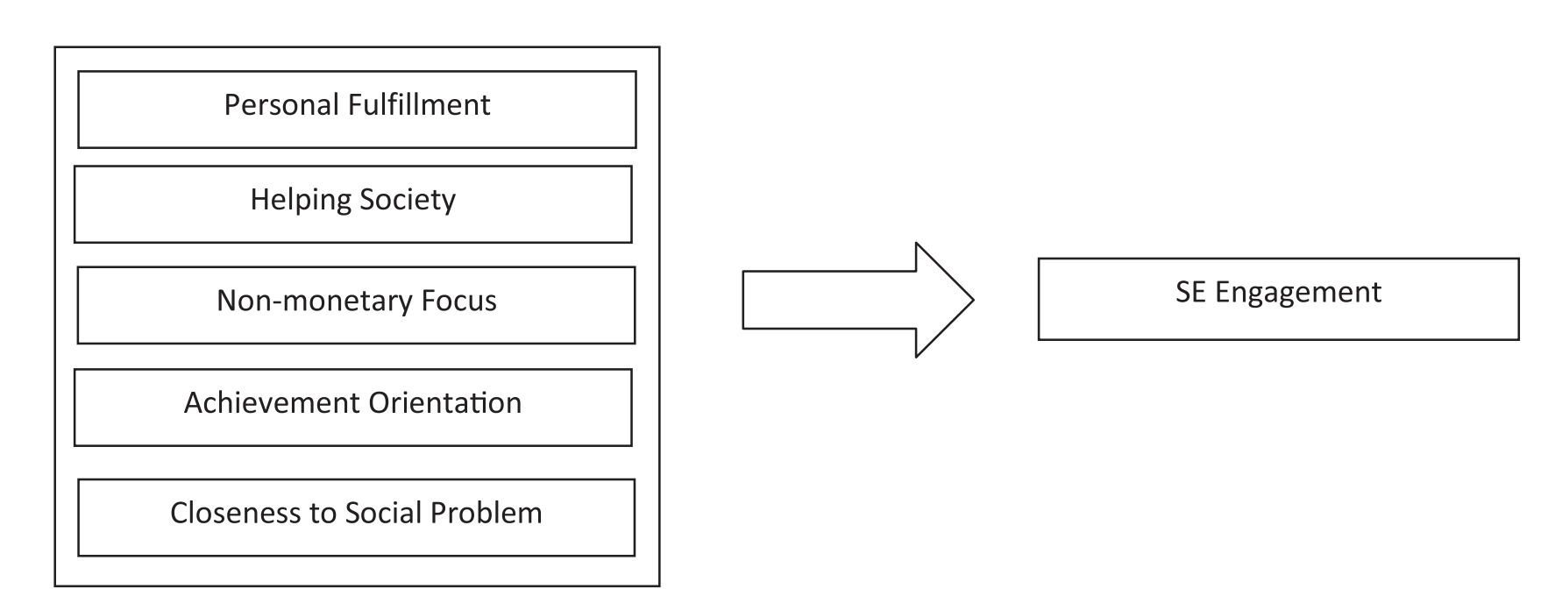
Theory [cont.]
Social enterprise motivation framework: Germak & Robinson (2014)

Slide 4
Sri Lankan non-STEM higher education trends in Social Enterprise Promotion
The concept of Social enterprise is emerging and its is in pre-paradigmatic status (Khun, 2000).
Unemployed graduates is a crisis of policies and priorities: only 3% of local graduate population are entrepreneurs (Chamara, 2023).
The mismatch between the needs of society and Non-STEM courses offered by universities has contributed to a high-level of graduate unemployment (Udayanga, 2023)
The economic crisis influences students’ motivations, sometimes prioritizing financial security over societal contributions.
Recent trends indicate an increased emphasis on integrating social enterprise concepts within the curriculum to foster Responsive Entrepreneurs that benefit society.

Slide 5
Research Problem
Literature verifies the importance of exploring the social enterprise intention of youth as they have potential to improve economic outcomes while promoting societal wellbeing.
However, the ongoing multifaceted crisis in Sri Lanka poses significant challenges, making it crucial to explore how financial constraints influence the inclination of youth towards social entrepreneurship or anti-social ventures.
Research Objective
To observe whether financial constraints influence the inclination of undergraduates in Sri Lanka towards social entrepreneurship over anti-social occupations

Slide 6
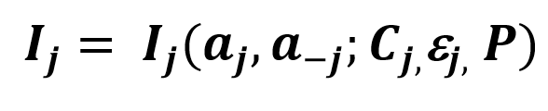
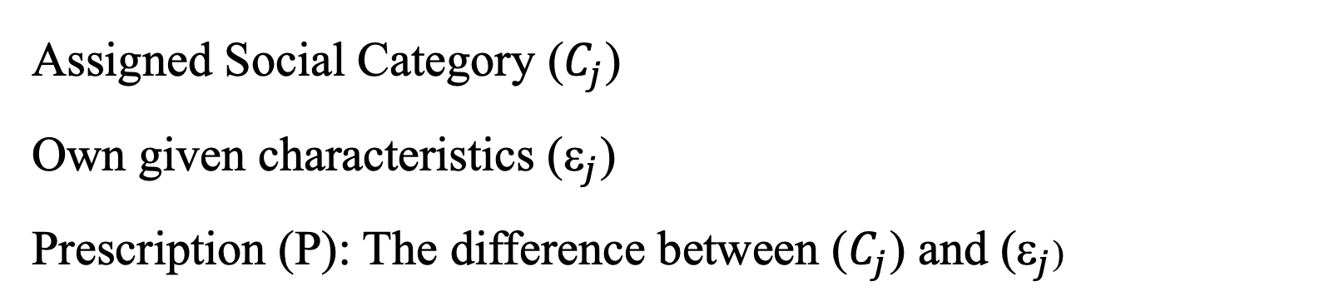
Theory [cont.]
Theory of Identity: Akerlof & Kranton (2000)
Assigned Social Category ($C_{j}$)
Own given characteristics ($_{j}$)
Prescription (P): The difference between ($C_{j}$) and ($_{j}$)

Slide 7
Methodology
We conducted choice experiments for studying youth engagement in two anti-social behaviours; ‘tax evasion’ and ‘earning from shadow economy’ with choices to optimize either the individual or societal wellbeing.
The experiment was processed using 240 undergraduates from the Faculty of Management and Arts, University of Peradeniya representing each academic year via eight sessions having thirty (30) respondents per each.
Participants went through four rounds and each round represented a different hypothetical situation considering the assigned characteristics [i.e., type of the job; different earning levels] and own given characteristics [i.e., education, experiences & expenses].

Slide 8
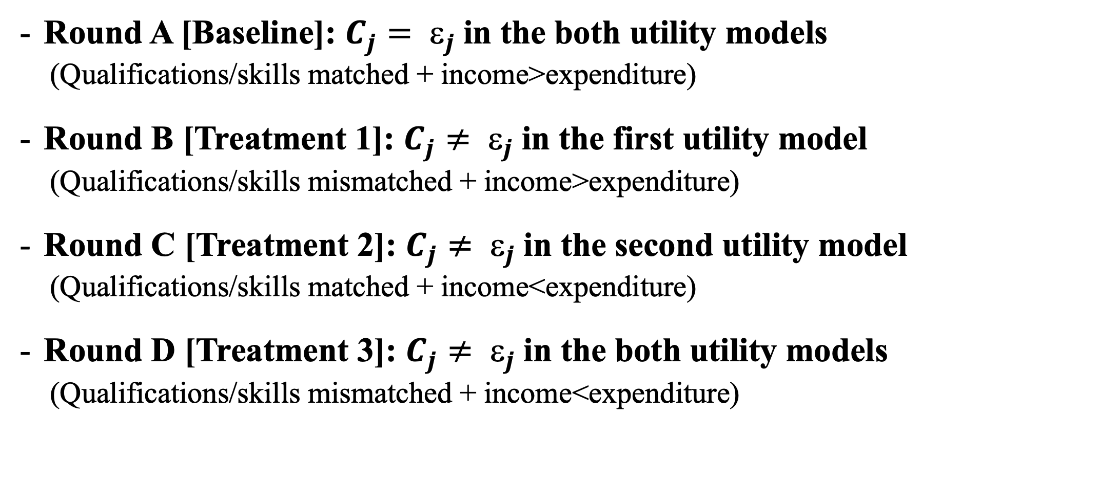
Methods [cont.]
Round A [Baseline]: $C_{j}= _{j}$in the both utility models
(Qualifications/skills matched + income>expenditure)
Round B [Treatment 1]: $C_{j}≠ _{j}$in the first utility model
(Qualifications/skills mismatched + income>expenditure)
Round C [Treatment 2]: $C_{j}≠ _{j}$in the second utility model
(Qualifications/skills matched + income<expenditure)
Round D [Treatment 3]: $C_{j}≠ _{j}$in the both utility models
(Qualifications/skills mismatched + income<expenditure)

Slide 9
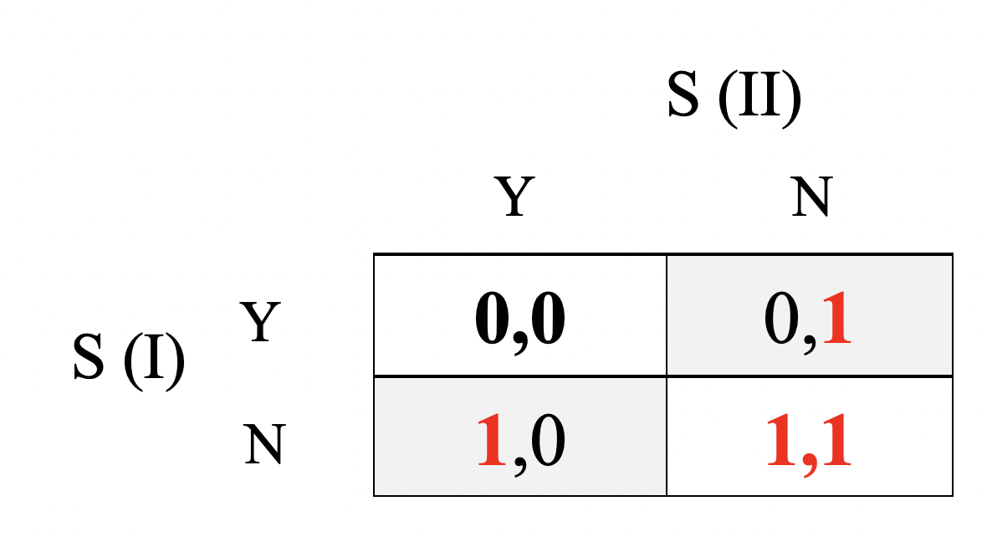
Out of all ten players |  |  | Your Earnings/Cost in each round (in points)
Enroll (E) | Not Enroll (NE) |  | If you take “E” |  |  | If you take “NE”
 |  |  | E (Numbers) | E (Your Points) |  | NE (Numbers) | NE (Your Points)
0 | 10 |  | 0 | - |  | 10 | 100
1 | 9 |  | 1 | 100 |  | 9 | 90
2 | 8 |  | 2 | 90 |  | 8 | 80
3 | 7 |  | 3 | 80 |  | 7 | 70
4 | 6 |  | 4 | 70 |  | 6 | 60
5 | 5 |  | 5 | 60 |  | 5 | 50
6 | 4 |  | 6 | 50 |  | 4 | 40
7 | 3 |  | 7 | 40 |  | 3 | 30
8 | 2 |  | 8 | 30 |  | 2 | 20
9 | 1 |  | 9 | 20 |  | 1 | 10
10 | 0 |  | 10 | 10 |  | 0 | -

Slide 10
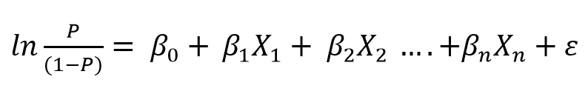
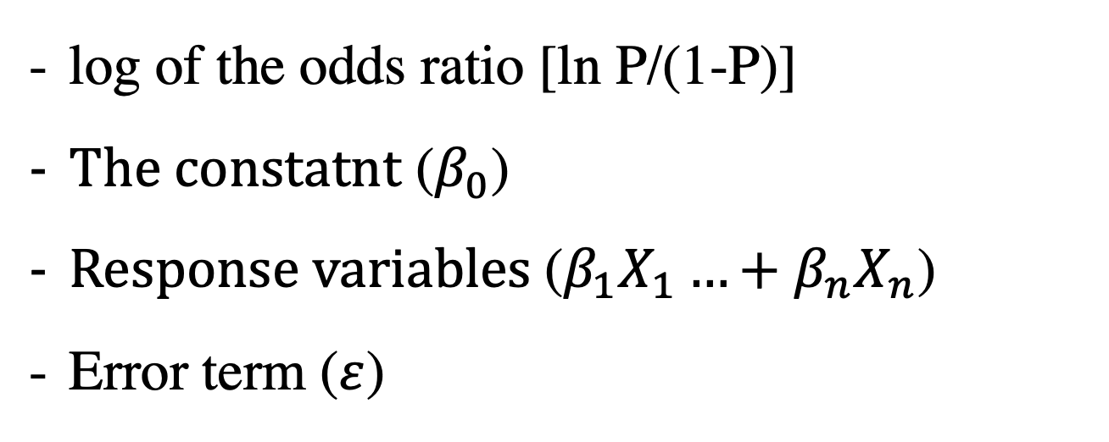
Methods [cont.]
The Binary Logistic Model (BLM)
log of the odds ratio [ln P/(1-P)]
$The constatnt$ ($β_{0}$)
$Response variables$($β_{1}X_{1}…+β_{n}X_{n}$)
Error term ($ε$)

Slide 11
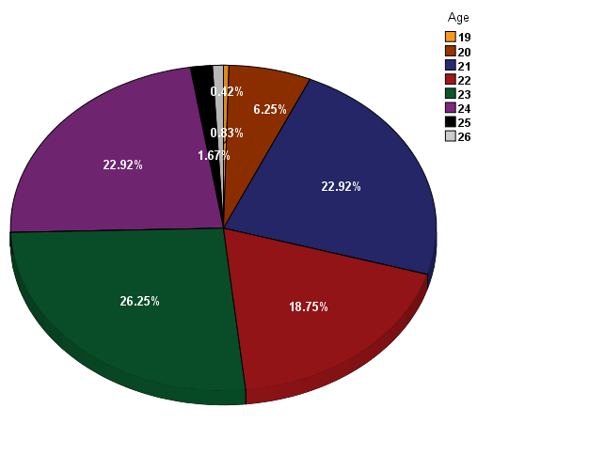
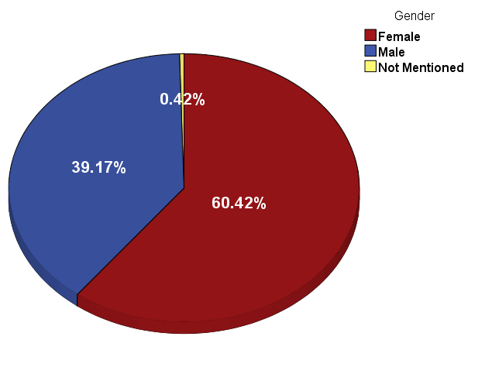
Results
Respondent’s Profile
Age profile of the respondents
Gender composition of the respondents

Slide 12
Estimated Respondents Preferences: The Best at Each Round
Round | Cluster | Preference | Value | Approx. | Score
1 | C-Self | ENROLL | 8.5 | 8.5 | 25
 |  | NOT ENROLL | 1.5 | 1.5 | 15
2 | B-Public | ENROLL | 8.25 | 8.0 | 30
 |  | NOT ENROLL | 1.75 | 2.0 | 20
3 | C-Self | ENROLL | 8.5 | 8.5 | 25
 |  | NOT ENROLL | 1.5 | 1.5 | 15
4 | C-Self | ENROLL | 8.625 | 8.5 | 25
 |  | NOT ENROLL | 1.375 | 1.5 | 15

Slide 13
The Binary Logistic Model (BLM)
Model Fitness: Baseline
Test for the Model Fitness | Fitness Index
Omnibus Test of Model Coefficients | Chi-square: 59.052, Significance: ***
Hosmer and Lemeshow Test | 0.967 (Significance level)
Nagelkerke R Square | 0.456
Model Fitness: Treatment 1
Test for the Model Fitness | Fitness Index
Omnibus Test of Model Coefficients | Chi-square: 65.190, Significance: ***
Hosmer and Lemeshow Test | 0.983 (Significance level)
Nagelkerke R Square | 0.426

Slide 14
The Binary Logistic Model (BLM) – cont.
Model Fitness: Treatment 2
Test for the Model Fitness | Fitness Index
Omnibus Test of Model Coefficients | Chi-square: 55.412, Significance: ***
Hosmer and Lemeshow Test | 0.854 (Significance level)
Nagelkerke R Square | 0.365
Model Fitness: Treatment 3
Test for the Model Fitness | Fitness Index
Omnibus Test of Model Coefficients | Chi-square: 44.277, Significance: ***
Hosmer and Lemeshow Test | 0.741 (Significance level)
Nagelkerke R Square | 0.314

Slide 15
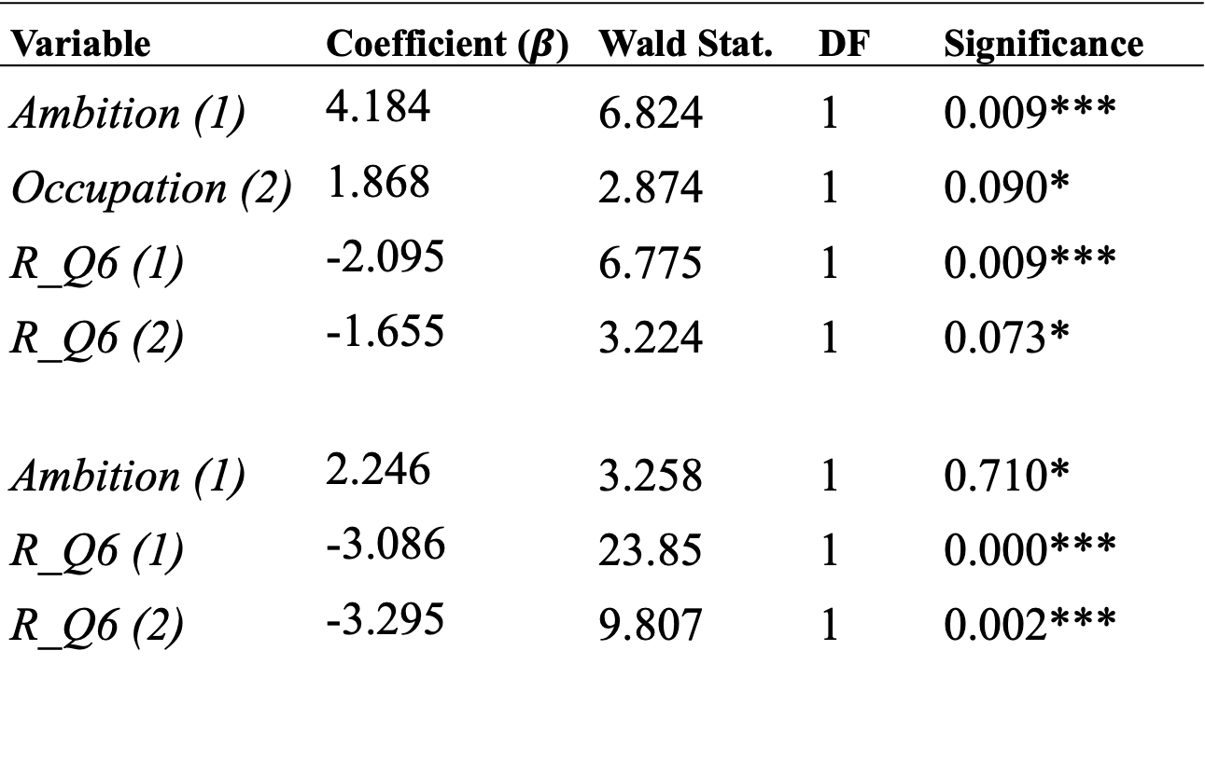
BLM: Estimated Variables
Variable | Coefficient ($β$) | Wald Stat. | DF | Significance
Ambition (1) | 4.184 | 6.824 | 1 | 0.009***
Occupation (2) | 1.868 | 2.874 | 1 | 0.090*
R_Q6 (1) | -2.095 | 6.775 | 1 | 0.009***
R_Q6 (2) | -1.655 | 3.224 | 1 | 0.073*
Ambition (1) | 2.246 | 3.258 | 1 | 0.710*
R_Q6 (1) | -3.086 | 23.85 | 1 | 0.000***
R_Q6 (2) | -3.295 | 9.807 | 1 | 0.002***
B
T1

Slide 16
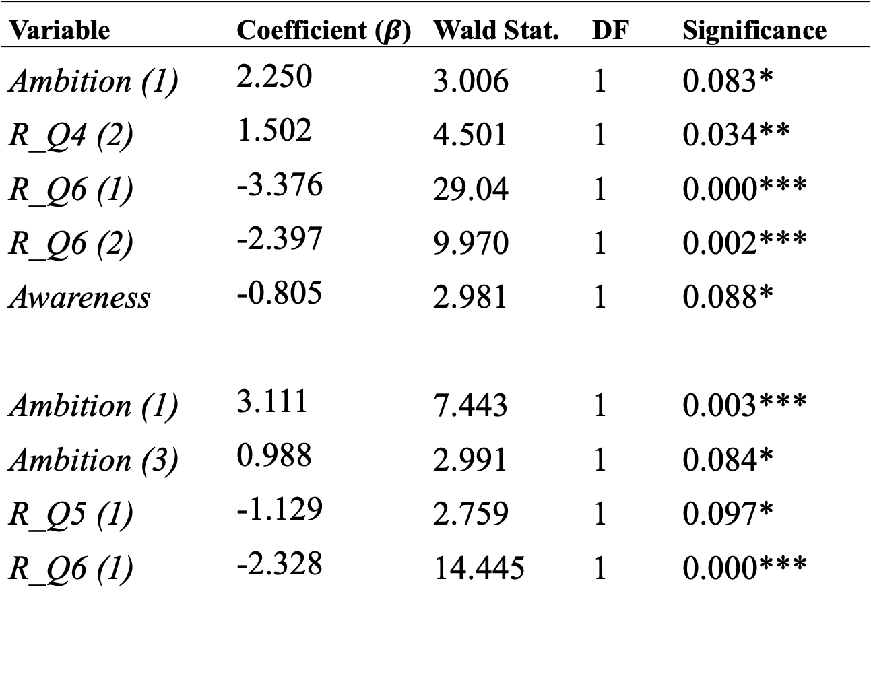
BLM: Estimated Variables (Cont.)
Variable | Coefficient ($β$) | Wald Stat. | DF | Significance
Ambition (1) | 2.250 | 3.006 | 1 | 0.083*
R_Q4 (2) | 1.502 | 4.501 | 1 | 0.034**
R_Q6 (1) | -3.376 | 29.04 | 1 | 0.000***
R_Q6 (2) | -2.397 | 9.970 | 1 | 0.002***
Awareness | -0.805 | 2.981 | 1 | 0.088*
Ambition (1) | 3.111 | 7.443 | 1 | 0.003***
Ambition (3) | 0.988 | 2.991 | 1 | 0.084*
R_Q5 (1) | -1.129 | 2.759 | 1 | 0.097*
R_Q6 (1) | -2.328 | 14.445 | 1 | 0.000***
T2
T3

Slide 17
Key Findings
The study found that income-driven underemployment significantly motivates individuals to engage in the shadow economy.
The pressure of financial constraints generated an adverse effect on the respondents’ prosociality and stimulates their engagement in anti-social occupations.
The pressure of financial constraints decrease the respondents’ purchasing power and stimulates their engagement in anti-social occupations.
The self-employed cluster demonstrated highest degree of prosociality.
The burden of income driven underemployment stimulate respondents to improve their engagement in anti-social occupations.
The respondents who disclosed lower ambitions enrolled significantly in anti-social occupations.

Slide 18
Implications
The majority from the sample of the experiment are motivated for anti-social occupations in response to the financial constraints and promotes private gains.
Financial constraints do matter in developing entrepreneurial motivation and people first attitude among undergraduates.
Pro-social motivation among undergraduates needs to be reinforced in order to increase potential SEs in Sri Lanka in the times of crisis.
Limitations
The laboratory experiment might not fully capture the real-world decision making behaviors
The study primarily examines the behavioral influences, not account for other factors like cultural norms, policy changes and external economic conditions
The study’s findings may be limited Sri Lankan youth, which may not be generalizable to other contexts.

Slide 19
Recommendations
Integrate pro-social motives and practices into curricula to influence the behavior and morality of undergraduates.
Develop programs to motivate and educate youth to express and expand their social enterprise intentions.
Implement strategies to reduce underemployment and its impact on the shadow economy.
Introduce progressive tax schemes to discourage participation in shadow economic activities and reduce adverse incentives from regressive taxes.
Create a more inclusive and sustainable economic system that benefits all, reducing anti-social activities.

Slide 20
References
Akerlof, G.A. & Kranton, R.E. (2000). Economics and Identity, The Quarterly Journal of Economics, 115:3, 715-753.
Ajzen, I. (1991). The theory of planned behavior. Organizational Behavior and Human Decision Processes, Theories of Cognitive Self-Regulation, 50, 179–211.
Germak, J. & Robinson, J.A. (2014) Exploring the Motivation of Nascent Social Entrepreneurs, Journal of Social Entrepreneurship, 5:1, 5-21, DOI: 10.1080/19420676.2013.820781.
Gagne, M & Desi, E.L. (2005) Self Determination Theory and Work Motivation, Journal of Organizational Behaviour, 26, 331-362, DOI: 10.1002/job.322
Maslow, A. H. 1943. “A Theory of Human Motivation.” Psychological Review 50: 370–396.
Rayan, R.M & Desi, E.L. (2000) Self-determination theory and the facilitation of intrinsic motivation, social development, and well-being, 55:1, 68-78, DOI: 10.1037110003-066X.55.1.
.

Slide 21
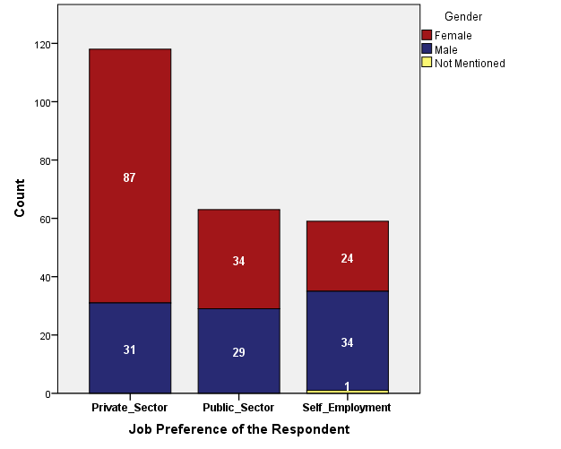

Results
Annexures

Slide 22
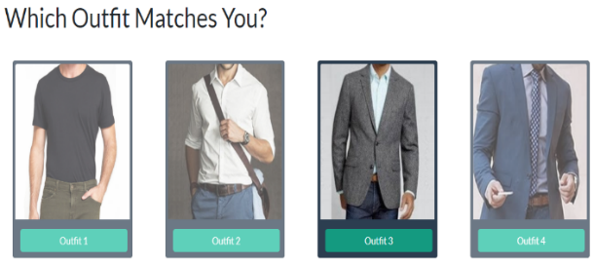
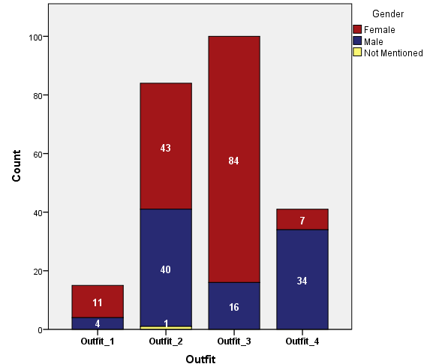

Results

Slide 23
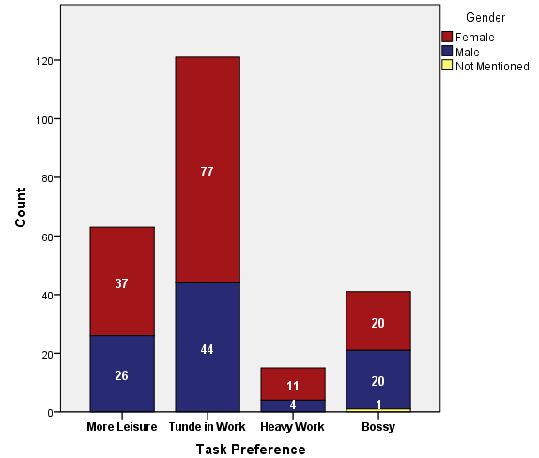

Results

Slide 24
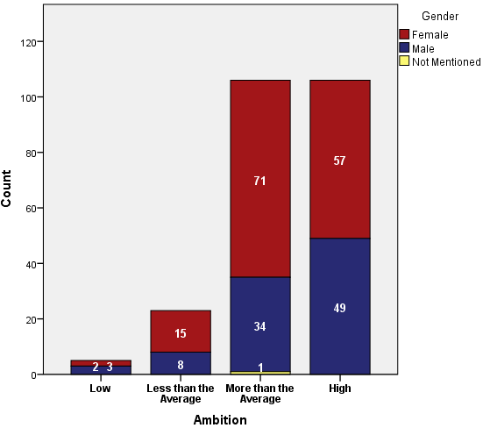
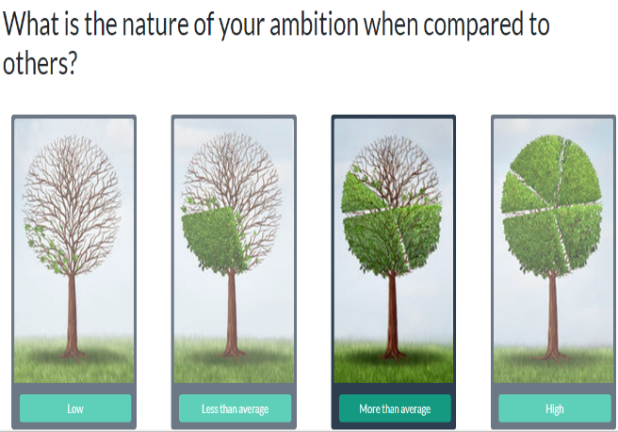
Results

Slide 25
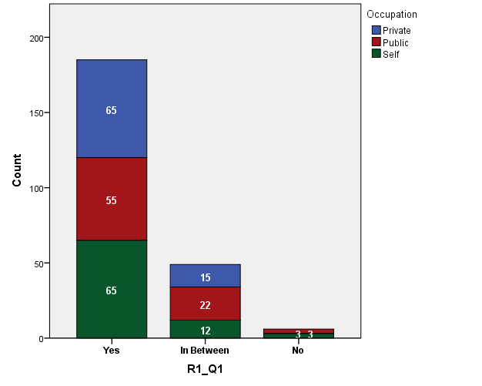
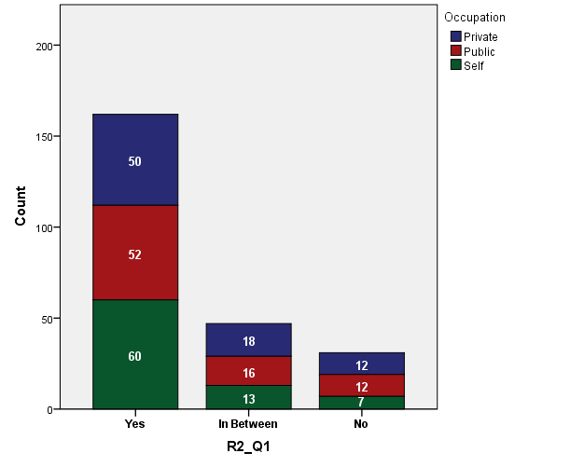
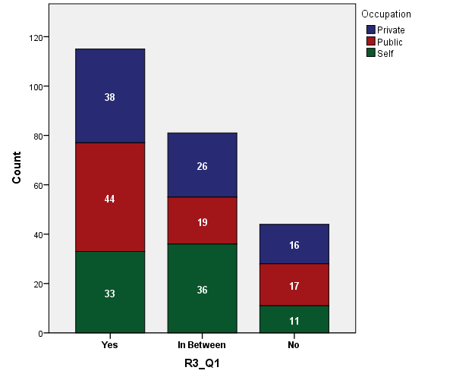
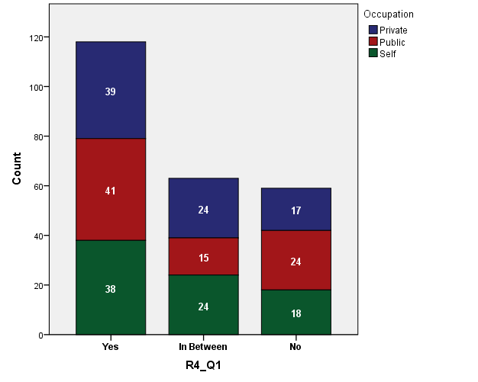
Satisfaction of the Respondents on the Occupation: Rounds 1-4
B
T1
T2
T3

Slide 26
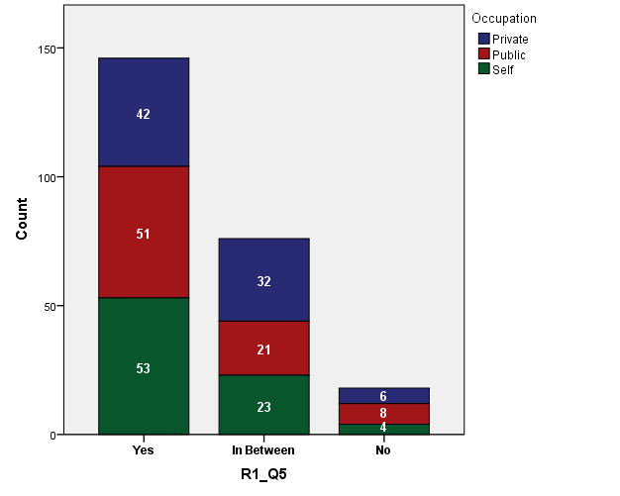
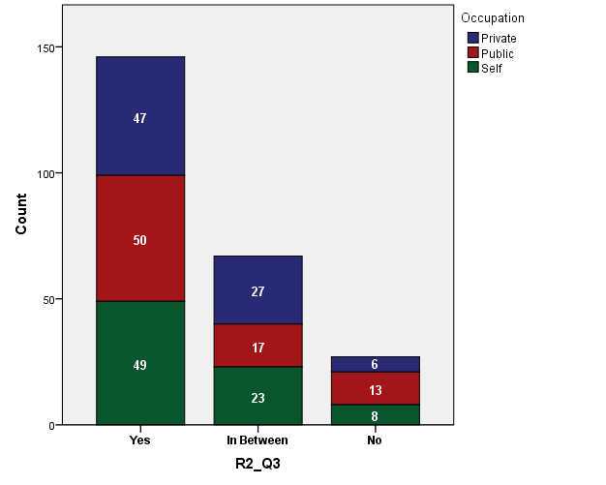
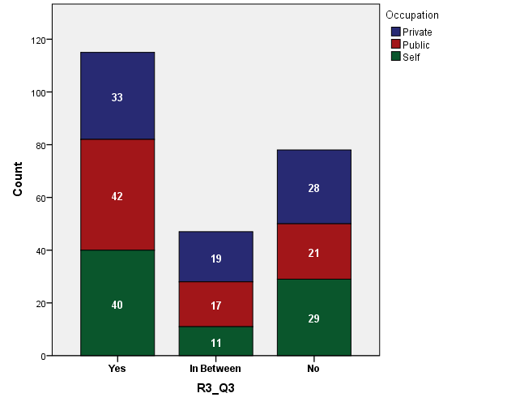
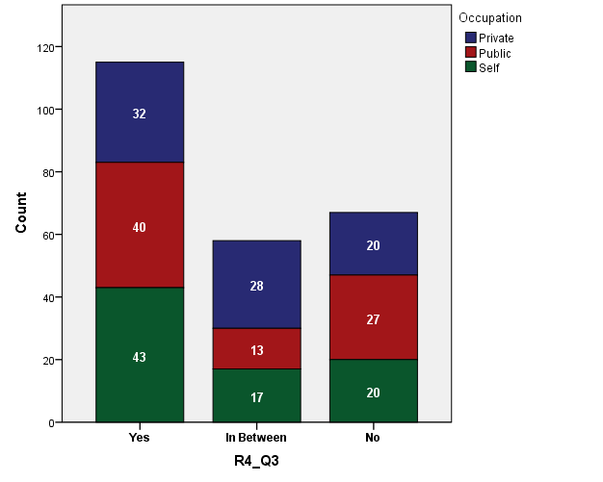
Willingness to pay tax on the official job: Rounds 1-4
B
T1
T2
T3

Slide 27
Thank You!
Acknowledgement: Deans of the Faculty of Management and the Faculty of Arts, University of Peradeniya for providing laboratory access together with permission to use undergraduates as subjects.

